Slide 1
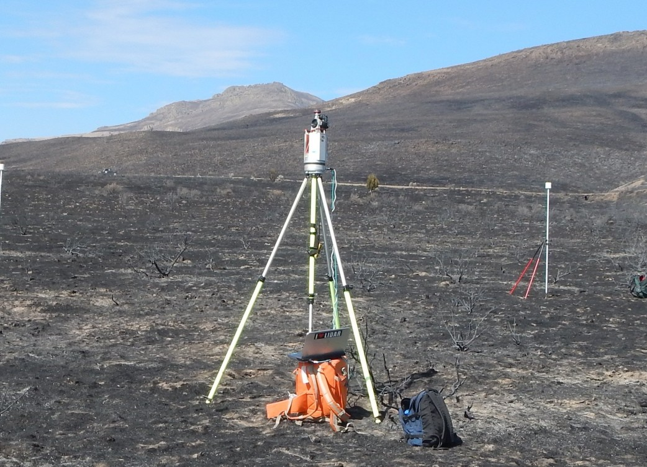
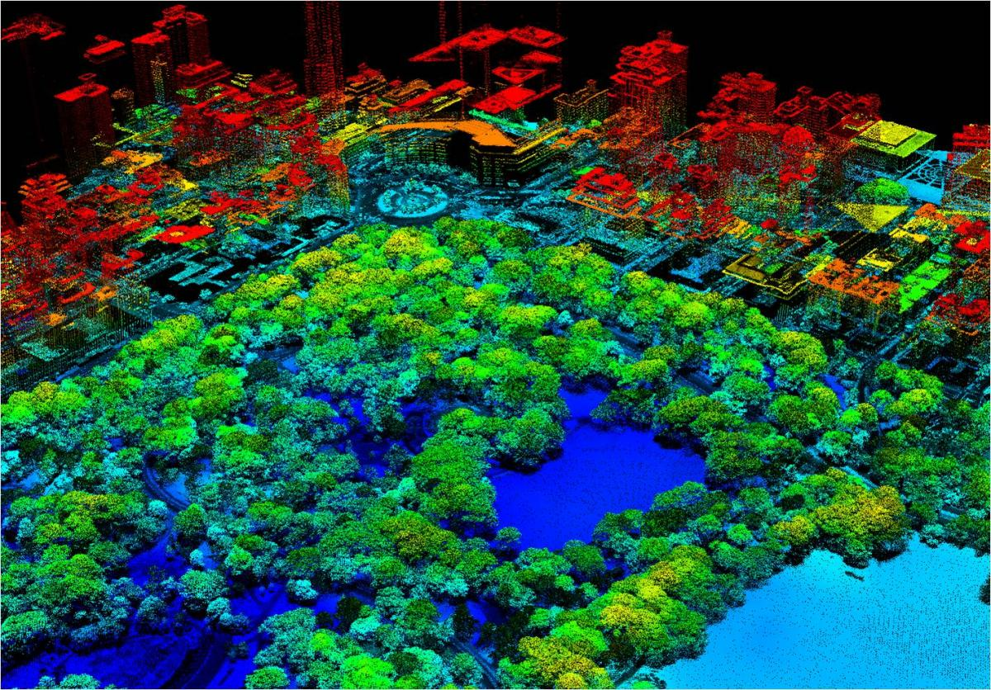
Introduction to Lidar

Slide 2
Lidar History
LiDAR technology dates back to the 1950s and 1960s.
In 1960, the first laser is introduced by Theodore Maiman
1962 the first LiDAR device is marketed by Hughes Aircraft
1971 the lunar altimeter is flown on Apollo 15.
1978 Johannes Riegl starts the Riegl company, one of the leaders in LiDAR technology
1984 the first bathymetric laser is used to map the Cambridge Bay.
1992 Geiger mode LiDAR is tested at MIT
2002 the first SLAM algorithm is created at Carnegie Mellon

Slide 3
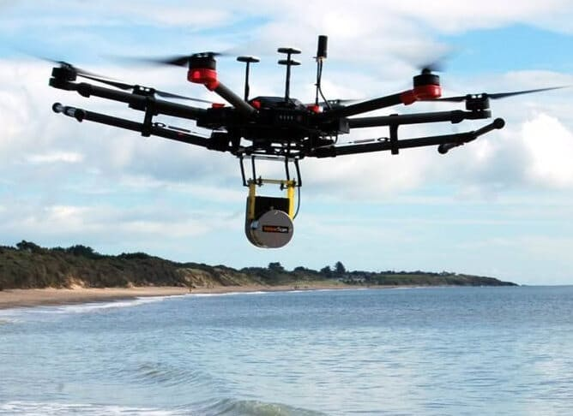
What is lidar
LiDAR – Light detection and ranging
It measures distances between transmitted and receive signals.
Three primary types: Pulse, Phase, Geiger mode
Pulse based emits a pulse of energy and measures the time it takes to hit a target and the time it takes to return.
Phase based measures distances by interferometry
Geiger mode use sensors that can be triggered by a photon and can fly higher than standard pulse based transmitters
We will focus primarily on pulse based emitters.
(see https://pdal.io/workshop/lidar-introduction.html for more details).
3. Four Primary types of scanning: Terrestrial, Airborne, Mobile, and Unmanned aerial system (UAS)
Velodyne on a UAS

Slide 4
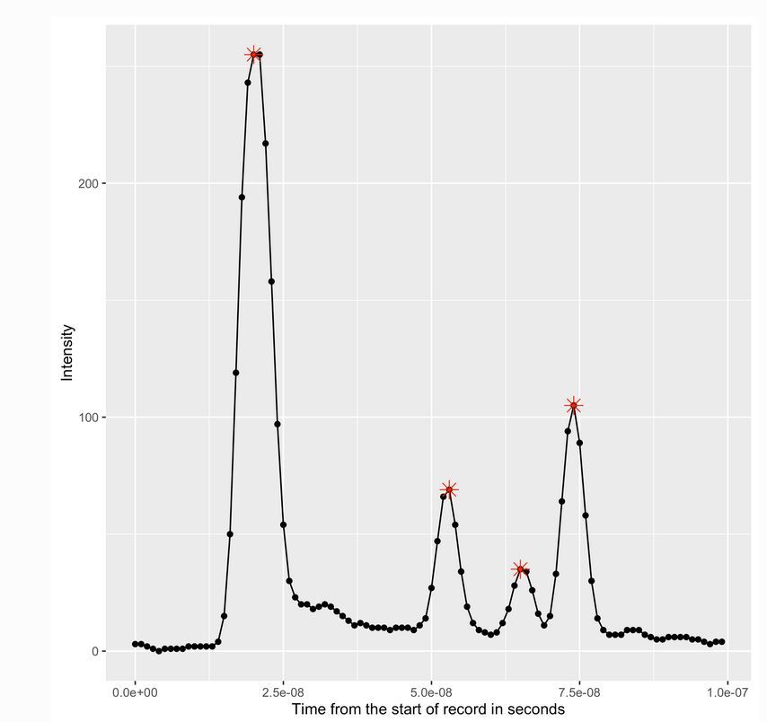

What is Lidar Part 2.0
Pulse LiDAR: Intensity vs Time
Basic LiDAR equation: $d= \frac{c∗t}{2}$ where $c=3.0 x {10}^{8}\frac{m}{s} (speed of light)$ , $t=pulse time$
One special feature of LiDAR: One pulse can lead to multiple returns, meaning more data can be collected from a single pulse.
With multiple returns, we can see the amplitude decreases so the greatest intensity will be from the first return.
Single return will bring back the first return, multiple returns will bring firstlast returns.
As a result of multiple returns, LiDAR is very effective for creating dense point clouds in plenty of settings, including heavy vegetation.

Slide 5
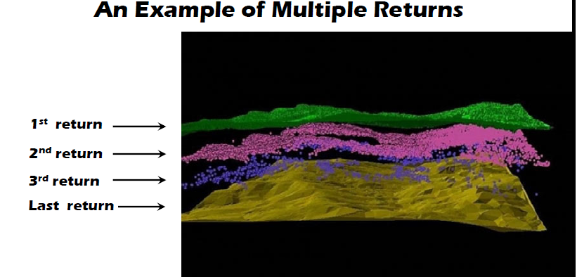

Slide 6
Lidar and accuracy: How confident are we in the scans?
Error can be laser error, human, and systematic error.
Laser error comes in the form of noise in the scanner, GNSS error, IMU error, etc.
Systematic and human error are the easiest to fix. Systematic errors can come from miscalibration in IMU lever arms, GNSS, boresight, etc. These can be fixed with calibration.
How do we determine the accuracy?
Done by statistical comparison between surveyed points and scanned points.
Use Root Mean Squared Error (RMSE) to determine accuracy

Slide 7


Some Useful equations
$$Range \left(R\right)= \frac{c∗t}{2}$$
$$Range Resolution \left(∆R\right)= \frac{c∗∆t}{2}$$
$$Maximum Range \left(R_{max}\right)= \frac{c∗t_{max}}{2}$$
$$RMSE= \sqrt{\frac{\sum_{i=1}^{n}{{\left(x_{meas}−x_{true}\right)}^{2}}}{n}}$$
Where:
$c=3.0 ∗{10}^{8}\frac{m}{s}$ (speed of light)
$t$ is the pulse time
$t_{max}$ is the maximum return time per pulse
$x_{meas}$ is the measured value
$x_{true}$ is the true value
RMSE is used to determine accuracy of point cloud (relative to “true” position)

Slide 8
Lidar data: how is it stored?
In the old days, LiDAR was stored in ASCII format, which was changed to a LASer file (LAS)
Note that this file type can be both LiDAR and EO point clouds. It doesn’t specifically have to be LiDAR.
Basic structure of an LAS file
File section | Use | Required
Public header block | Stores basic summary data | Yes
Variable length records | Metadata storage | No
Point data records | Data points | Yes
Extended variable length records | Store waveform data | No

Slide 9






Georeferencing: an intro
To understand georeferencing, we first need to understand vectors and vector addition
$$\vec{a}+ \vec{b}$$
$$\vec{a}$$
$$\vec{−b}$$
$$\vec{a}− \vec{b}$$
Or
$$\vec{a}+\vec{−b}$$
$$\vec{b}$$
$$\vec{a}$$

Slide 10
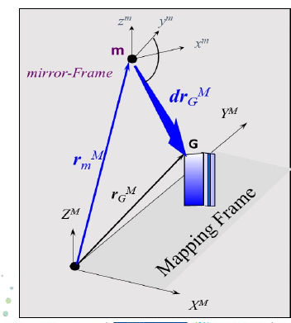
Georeferencing – Basic IdeA
LiDAR mirror (m) measures range to object G
IMU and GNSS measures position and orientation with respect to the mapping frame.
Mapping frame may either be georeferenced or relative to some other global frame
Hence, we can compute the position of object G to the mapping frame.

Slide 11
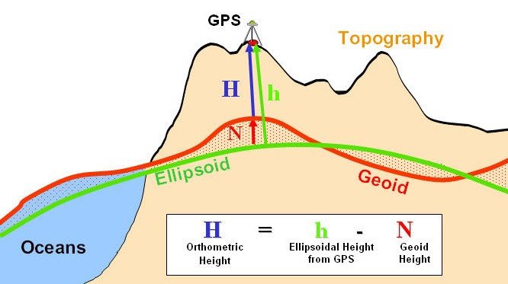
Quick review!!
H – terrain/orthometric height.
Geoid (N) – mean sea level (if oceans were at rest)
Geoid is based on gravitational measurements at every point on earth)
Ellipsoid – mathematical model of the actual shape of the earth
https://wiki.gis.com/wiki/index.php/Geoid

Slide 12

Lidar processing – Aligning Scans together
There has been a plethora of research in georeferencing LiDAR/point cloud data. The standard georeferencing equation is as follows:
$$P_{G}^{l}= P_{GPS}^{l}+ R_{b}^{l}(R_{s}^{b}r^{s} − l^{b})$$
$P_{G}^{l}$ - target point in the global reference frame (geolocated point)
$P_{GPS}^{l}$ - coordinates of the GNSS sensor
$R_{b}^{l}$ - Rotation matrix from scanner frame to global frame
$R_{s}^{b}$- Boresight matrix -boresight matrix describe the misalignment angles between the IMU and the reference frame (LiDAR frame)
$r^{s}$ - Coordinate of point in the scanner frame
$l^{b}$ - lever arm offset between scanner origin and navigation origin
2. Mobile LiDAR units make use of GNSS and IMU’s (inertial measurement unit) to detect orientation and displacement of the LiDAR device. IMU’s measure acceleration to measure movement. (http://www.starlino.com/imu_guide.html)
3. In GPS denied areas, one may use robotic operating systems (ROS) to align consecutive scans via SLAM algorithms (Simultaneous Location and Mapping)

Slide 13
SLAM AND ROBOTIC OPERATING SYSTEMS (ROS)
Numerous SLAM algorithms use robotic operating systems in LiNUX to map LiDAR point clouds, specifically in GPS denied areas.
ROS has 4 primary components: Nodes, Messages, Topics, and Bags (aka bag files )
a. Nodes are used to make computations.
b. Messages are the ways in which nodes communicate.
c. Topics nodes communicate by publishing to a topic (such as the odometry)
d. Bag files save and play back ROS messages data.
Find out more at https://wiki.ros.org/ !!!

Slide 14

So we have a Lidar point cloud….what interesting things can we do?...
LiDAR Processing is similar in traditional digital image processing: We are interested in feature extraction, DTM,DSM,DEM, etc.
QUICK REVIEW!!!!!!!
DTM – digital terrain model – point to point representation of the bare earth.
DEM – digital elevation model – rasterized representation of the bare earth.
DSM – digital surface model – point representation of the surface of the earth. This includes trees, buildings, etc.
Why are we interested in these?
Since LiDAR scans can be very dense, we can generate high resolution DEMs to get an accurate representation of ground elevation.
Surveyors use LiDAR scans in lieu of traditional methods because it’s less cumbersome and can produce highly accurate data.
A practical application is generating tree height models in forestry applications. This is done by taking
$$DSM −DTM$$
Interested in classifying point clouds in the same way we are interested in classifying images.

Slide 15

Lidar Processing
Outlier Removal
Often times point clouds will have random noise (random points in space)
This can be the result of points hitting dust, rain, error in georeferencing, etc.
First step is often removal of outlier points via radial or statistical methods.
2. Basic idea (statistical):
Use statistical methods for removing outlier points.
First, for each point, compute the mean distance, μ_{i} to each of it’s k nearest neighbors (k being a value you input)
A global mean μ is then computed of all the μ_{i} hence
$$μ= \frac{\sum_{i=1}^{n}{μ_{i}}}{n}$$
Then the standard deviation of μ_{i} is calculated:
$$σ=\sqrt{\frac{\sum_{i=1}^{n}{{{(μ}_{i}−μ)}^{2}}}{n−1}}$$
We decide a threshold for the outlier, t, based on μ and σ.
$$t= μ+mσ$$
Where m is a user input value. Hence, any point p with $μ_{i}$ that surpasses t is an outlier.

Slide 16

Radial outlier filter
Radial outlier measures point density within a neighborhood of points.
For each $p_{i}$ the number of neighbors $k_{i}$ within a radius $r$ . If $k_{i}<k$, then the point is marked as an outlier (where k is defined by the user).
2. The outlier method is up to the user. Considerations need to be made when it comes to the outlier filter. Additionally, the user must look at the point cloud in order to determine the parameters for r,k,etc.

Slide 17
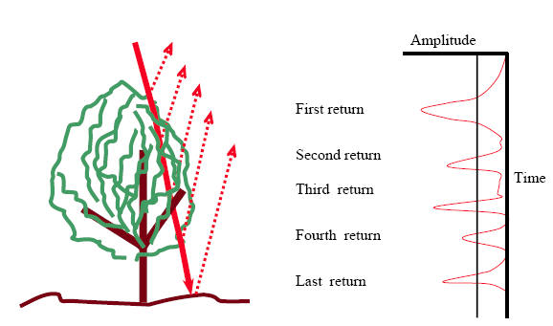
Getting grounded….
Once we get the outliers removed, we often will get the ground as well.
The ground is important for DTM and DEM creation as specified earlier.
So how do we get the ground?....
Remember return numbers?....
Often (especially in forest regions) the last return will be the ground as LiDAR will penetrate trees.
Is this sufficient? What about urban areas?....

Slide 18
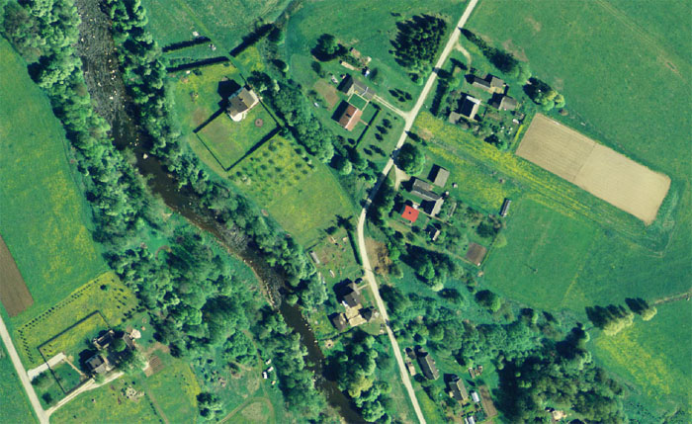
How might I get the ground in this area?

Slide 19
How to get the ground
We can generally make 2 assumptions about the ground:
They consist of the lowest points in the dataset.
The slope of two ground points will be less than points that are not ground points. I
In other words, points that are on buildings, trees, etc will TYPICALLY have a greater slope than ground points.
There are numerous ways to extract ground points, including slope based methods
The ones we will focus on are morphological filters, as it will be used in the software we use later.

Slide 20

Morphological filters
Two primary filters: Progressive morphological filter and Simple morphological filter.
Morphological filters are based on 2 operators: dilation and erosion.
These operations are typically used for images but can be applied to LiDAR points.
Let p = p(x,y,z) be a point in a point cloud. Let w be a window around p and (x_{p} , y_{p} , z_{p} ) be a neighbor point of p in w.
Dilation: For point p and a given window, $d_{p}=\max\left(z_{p}\right)for \left(x_{p},y_{p}\right) in w$
Erosion: For point p and a given window, $e_{p}=\min\left(z_{p}\right)for \left(x_{p},y_{p}\right) in w$
Opening Operation: erosion then dilation
Closing Operation: dilation then erosion
Difficulty picking window size. For example: If window is too small, buildings will be classified as ground. Too large will classify ground points as non-ground (if the slope is large enough).

Slide 21
Morphological filters continued
Erosion operation helps remove tree returns smaller than the window, dialation retains building returns.
2. Progressive Morphological filters use a gradually growing window size to handle choice in window size.
This helps ensure buildings, trees, etc. are excluded from the ground classification while maintaining terrain integrity (such as hills, rocky terrain, etc.)
An initial filtered surface is created by a window size. Buildings larger than the window are classified as ground while trees are removed.
A second filter applied with a different window size. It removes building returns and a new minimum elevation is calculated.
Does this iteratively until it reaches the maximum window size.

Slide 22
Processing Data
Outlier removal
Ground Classification
Segmentation/Classification
We will be using open source software to process LiDAR data. The software is called PDAL (point data abstraction library).
There are a number of software packages that will process data (QT modeler, cloud compare, LAStools, etc)

Slide 23
Segmentation and Classification
There are a number of ways to segment point clouds.
Unsupervised
Kmeans:
Kmeans clustering algorithm based on cluster centers and predetermined cluster numbers
Cluster center is the mean of all points in the cluster
Expectation maximization
Requires clusters to be well-defined
DBSCAN
density-based spatial clustering of applications with noise
Capable of detecting arbitrary shapes of many dimensions.
Requires 2 parameters: search radius and minimum number of points (minPnts)

Slide 24
Segmentation and Classification cont.
Besides using clustering algorithms, we can use the shape of the actual point cloud in order to classify things such as buildings, trees, etc.
PDAL has built in rank estimators (shape estimators) to determine “shape” of a point cloud.
3. We also can calculate planes based knn nearest neighbors of a point.
4. We can calculate the normal vector as well as curvature of a point. From here, we can use clustering algorithms to segment.
5. We will talk about how to do this next class when we cover PDAL

Slide 25

First, let’s figure out eigenvalues are calculated in point clouds.
Eigenvalues of a point cloud are based on k-nearest neighbors and are based on the distance of each point to the centroid.
$$C= \frac{1}{k}\sum_{i=1}^{k}{\left(p_{i}−p_{c}\right)∗({p_{i}−p_{c})}^{T}}$$
Where $C$ is the covariance matrix
$p_{i}$ is a point in the k-nearest neighbors
$p_{c}$ is the centroid of the k-nearest neighbors
2. Hence, we have the following eigenvalues and eigenvectors:
$$C v_{j}= λ_{j} v_{j}$$
Where $j=1,2,3$
$v_{j}$ is an eigenvector
$λ_{j}$ is the corresponding eigenvalue

Slide 26

Approximately coplanar points and rank
PDAL uses eigenvalues computed by K nearest neighbors to determine if points are coplanar.
$$\left(λ_{2}>s_{α}λ_{1}\right)∩{(s}_{β}λ_{2}>λ_{3})$$
Where $λ_{1},λ_{2},λ_{3}$ are the eigenvalues of the covariance matrix of k-nearest neighbors and $s_{α}, s_{β}$ are user parameters (usually can keep PDAL defaults which are 25 and 6 respectively)
2. This determines whether a neighborhood of points belong to a plane or not.
3. Estimate rank uses singular value decomposition of the covariance matrix to determine the rank of a point (i.e. shape).
A point of rank 1 is linear, 2 is planar, and 3 is a 3d object
4. We can use these values to determine shapes of points and hence classify them.

Slide 27
Sources

